Slide 1
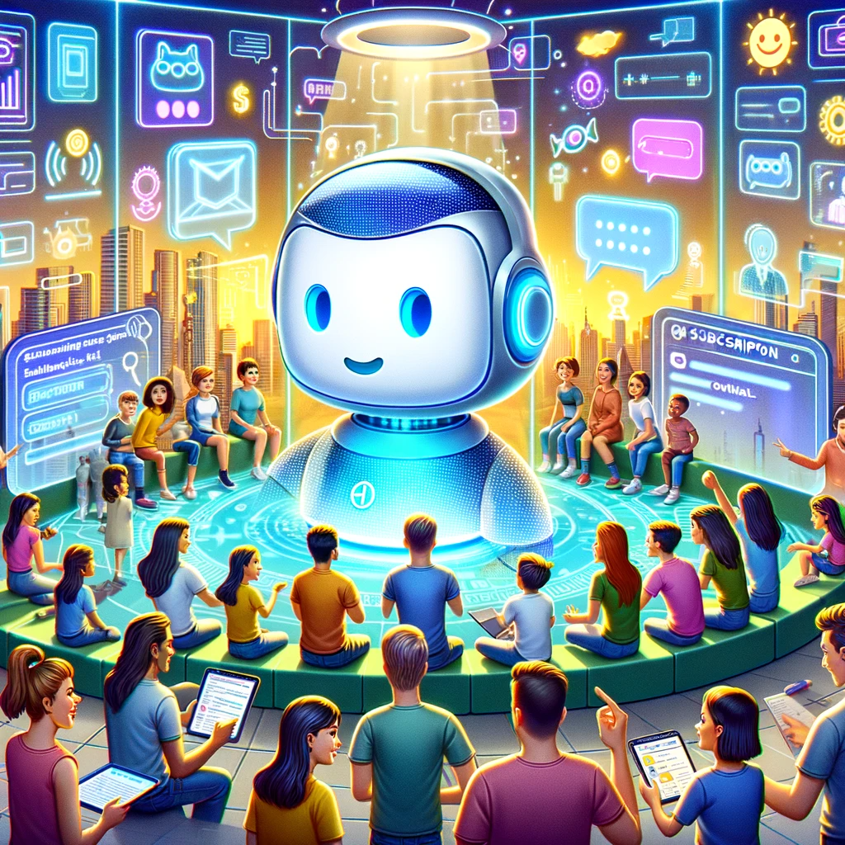

Understanding the ChatGPT subscription Levels

Slide 2
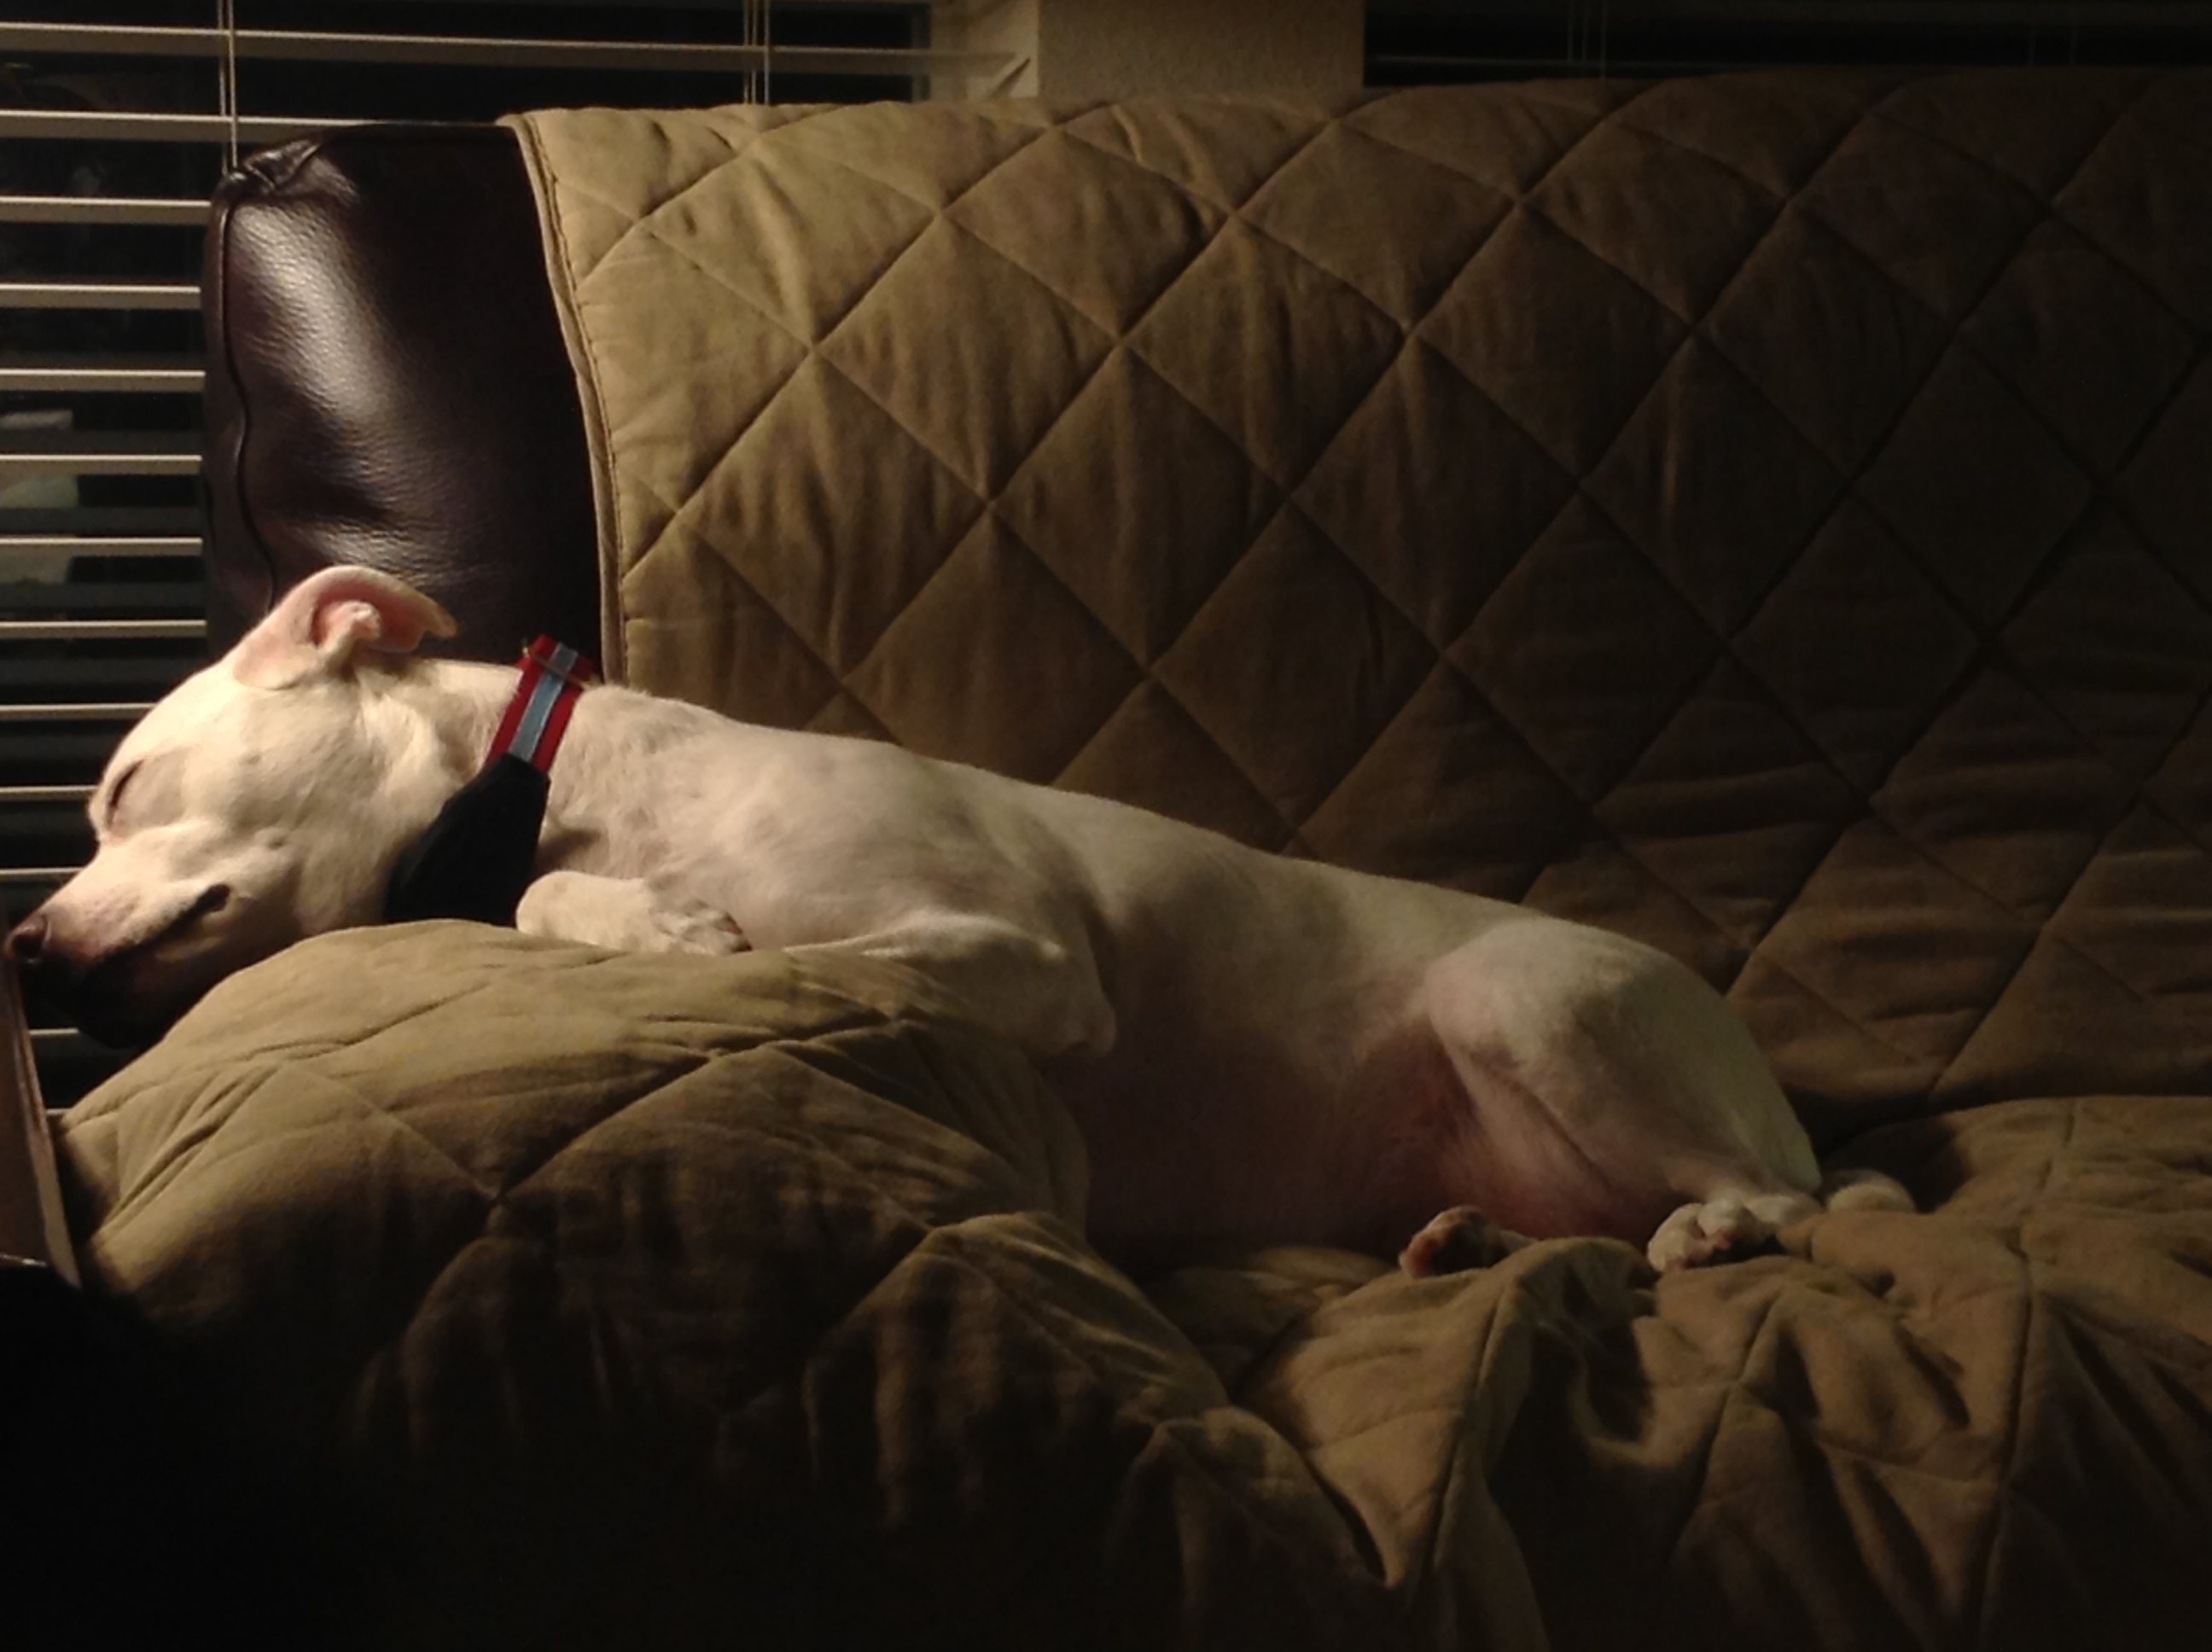

Slide 3

“I refuse to join any club that would have me as a member”
- Groucho Marx
Notes:
https://openai.com/blog/introducing-the-gpt-store

Slide 4
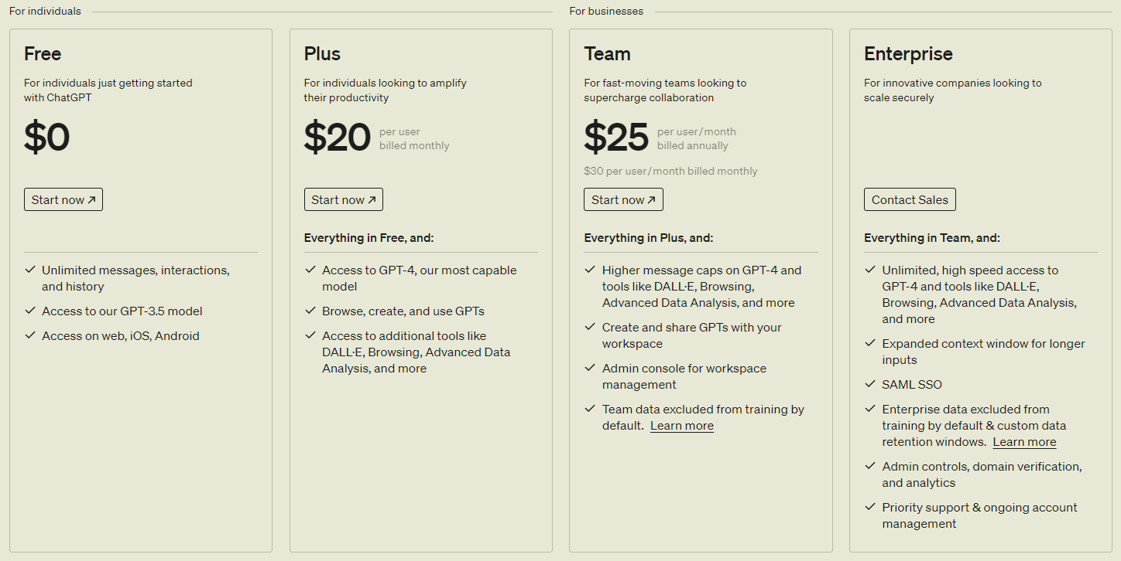

Slide 5
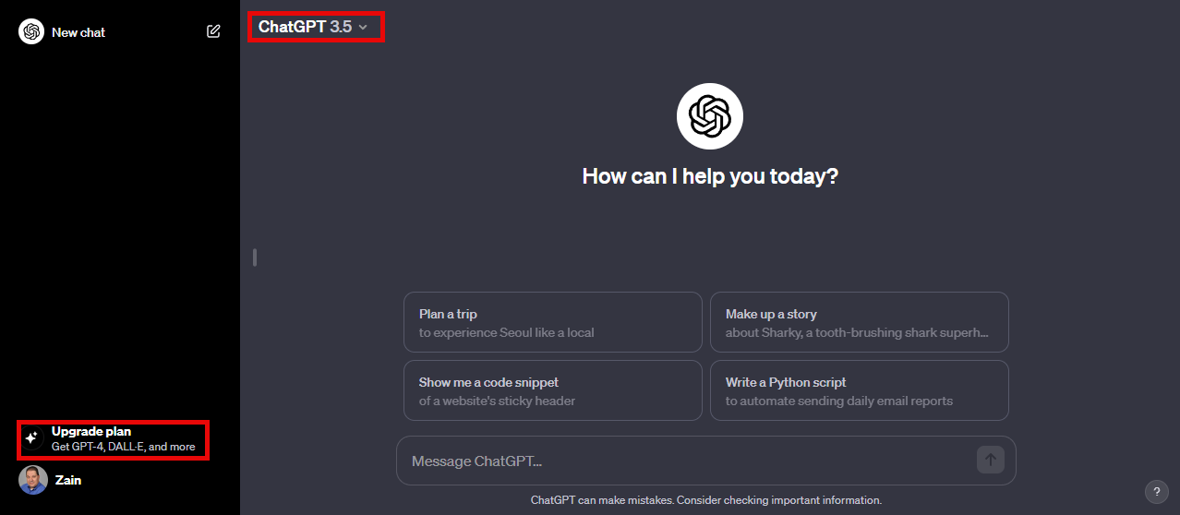
Free Plan
Notes:
https://chat.openai.com/gpts

Slide 6
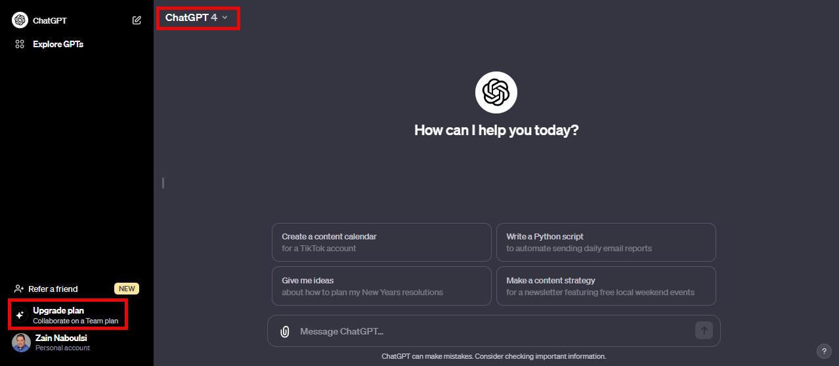
Plus Plan

Slide 7
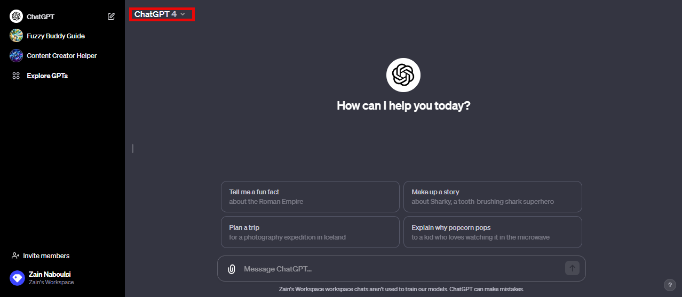
Team Plan

Slide 8

Enterprise Plan

Slide 9


